Slide 1


Insights to Leading an Agile Team with .
Field
Agile software development
Location
USA
Team members
60

Slide 2
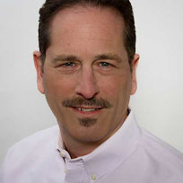
Insights to Leading an Agile Team with TeamMood
Andy is an Agile Coach and Senior Scrum Master at a Fortune 50 company. He serves multiple cross-functional software development teams (composed of engineers, UI/UX designers, product owners, testers, etc ...) who are building a national ecommerce platform.
The situation
One of his key challenges relates to the distributed nature of his team. To foster communication and collaboration, the teams are using tools like Slack and JIRA, but those platforms don’t do all that much to develop empathy nor give a visual representation of the heartbeat of the team - like meeting around the watercooler would (one can only do so much with emoticons!)
How does Andy use TeamMood?
1
To gain insights on his teams’ moods and feelings on a daily basis and to spot trends over time
To gather feedback via comments on a contemporaneous basis
To get a leading indicator of team performance
2
3
“How powerful would it be to visualize the pulse of your team on a daily basis?”

Slide 3
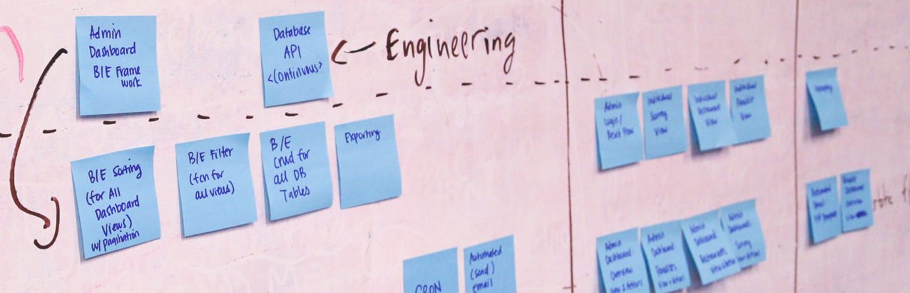
Gain Insights on Teams’ Mood
“Some tools are designed to monitor team health quarterly or annually, but I was looking for a real-time indicator, and I found TeamMood.”
“TeamMood makes it easy to gather data daily, and by using tags, drill down to specific functions or roles for a large team. And even track multiple teams. And then I can visualize trends over time and identify inflexion points.”
“Seeing the pulse of the teams with such clarity gives me the opportunity to be a better coach - responding in near real time.”
Gather Feedback
TeamMood not only provides insights into the mood of a team, it also gives the opportunity for each teammate to share his or her comments contemporaneously.
“When individual team members are willing to share anonymously what makes them happy and sad, the whole team can benefit. I’ll tap into the comments when designing an upcoming retrospective. And as a team we can discuss making sure we don’t lose the elements that contribute to happiness, and that we strive to reduce or eliminate that things that make us sad.”

Slide 4
Foreseeing Outcomes
According to Andy, “a team’s mood is a leading indicator of what’s going to happen soon. A happy team is an engaged, performing team. Such a team creates better solutions, with higher quality than a consistently unhappy team. Better delivery results in happier customers. And that yields happier stakeholders.”
“On the other hand, if the mood of the team is dropping, I can be pretty sure that without some intervention a drop in productivity will follow. Seeing a downward trend gives me the opportunity to respond proactively.”
Keeping track of the team’s health is especially vital for an agile team, for which each day can be decisive, and a team’s progress toward their sprint goals depends on each and everyone’s collective contribution. “Is it time for a happy hour mid sprint? Or an hour break for some serious play-time? With TeamMood it’s easy for a scrum master to know!”
Healthy Agile Teams
“A lot of companies experiment with ways of measuring and visualizing how their teams are doing (KPI’s, ROV’s, NPS, etc.,) looking for areas where there are opportunities for improvement. The general idea being you can’t improve what you don’t measure. And without some sort of systemic approach with clear visualization – things would very much be a guessing game. TeamMood provides just that.”
“Team mood is a leading indicator of team performance.”

Slide 5
Let the TeamMood app help you track the well-being of your team
Get started

